Slide 1
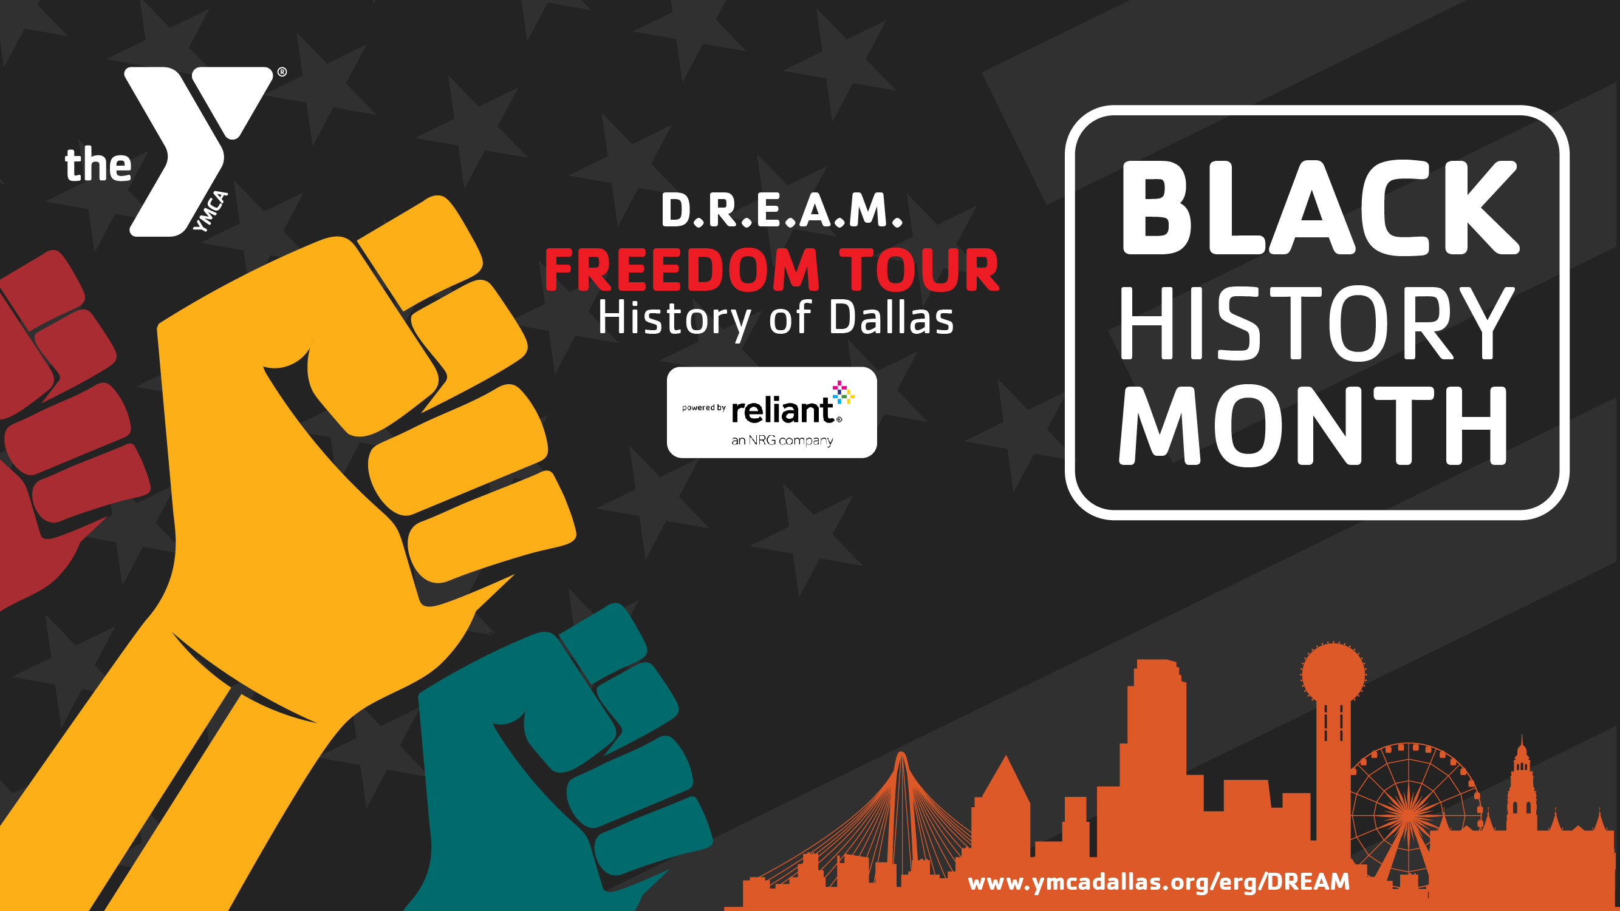
WEEK: 2
Notes:
Music from Fisk Jubilee Singers - Rock My Soul

Slide 2


No Justice, No Peace!!
D.R.E.A.M FREEDOM TOUR – History of Dallas

Slide 3
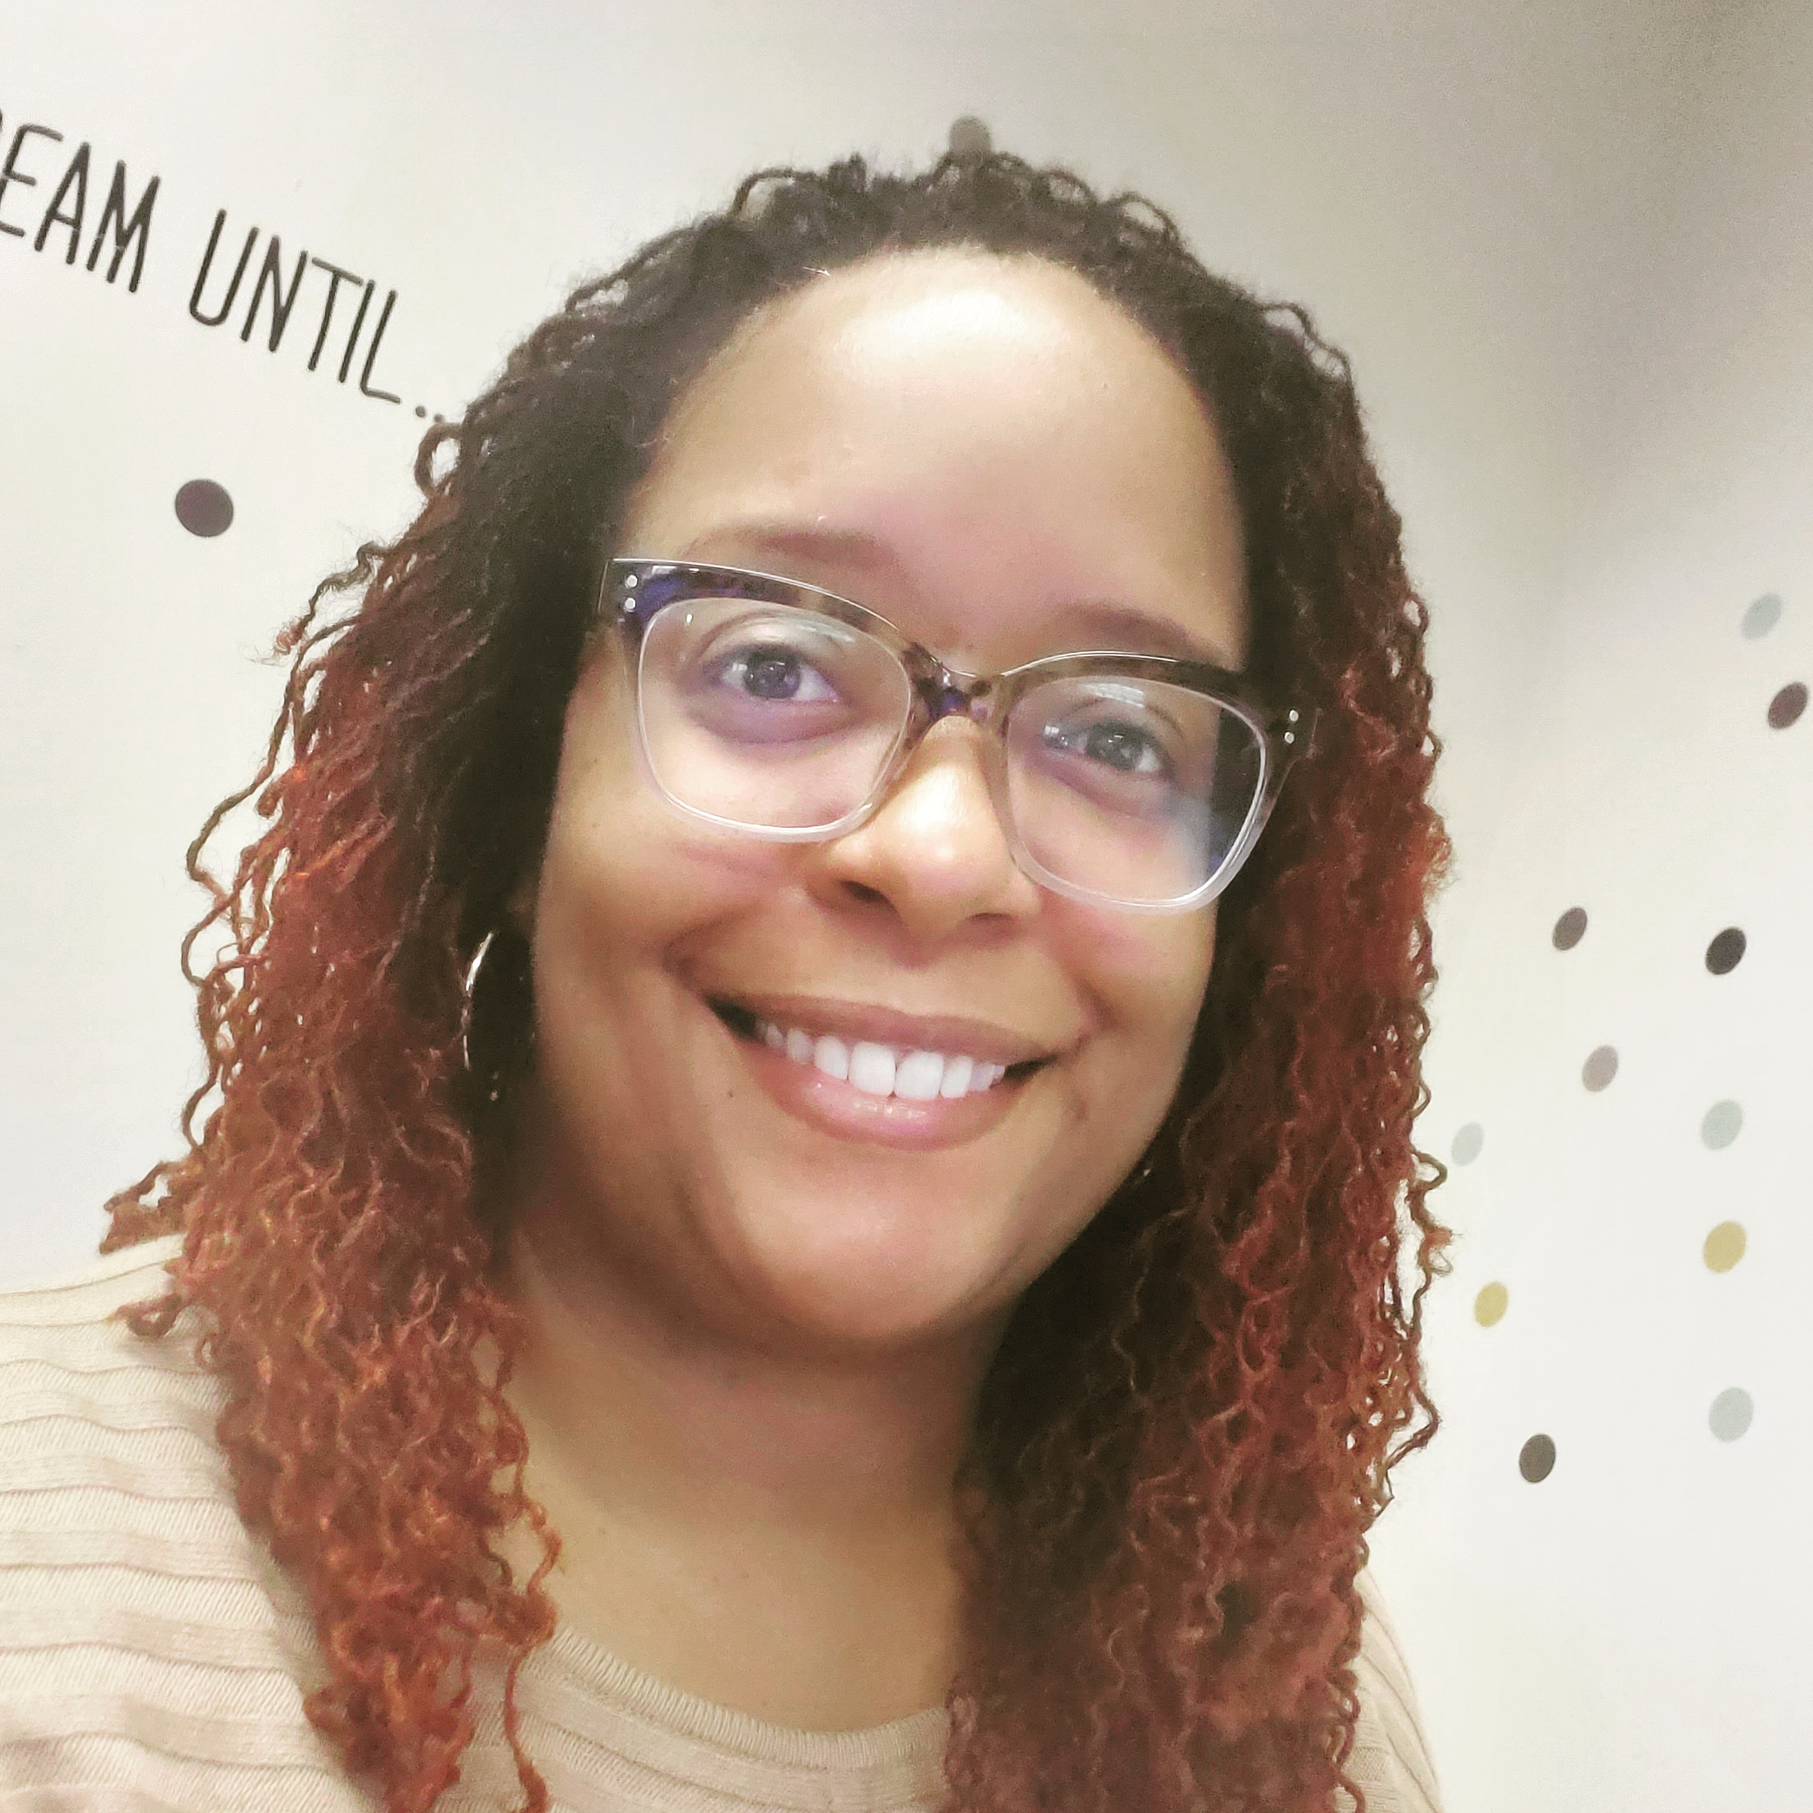
WELCOME
D.R.E.A.M FREEDOM TOUR – History of Dallas
Melanie "Tricey“ Love
Executive Director
YMCA OF METROPOLITAN DALLAS

Slide 4
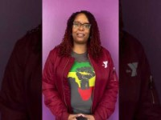
WELCOME
D.R.E.A.M FREEDOM TOUR – History of Dallas

Slide 5

AGENDA
WELCOME
UNCOVER & UPLIFT MESSAGE
TOUR OF OLD NORTH DALLAS
BREAKOUT SESSION
GROUP DISCUSSION
CLOSING THOUGHTS
Notes:
How do you think changes in city redevelopment affect communities like Old North Dallas? (Highways, Railroads, and ____ )
How do you think the Reconstruction Period affected communities like Freedman’s Town?
Provide specific examples within your groups.

Slide 6
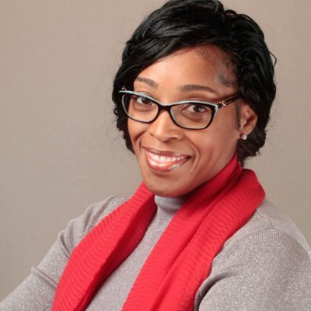
UNCOVER & UPLIFT
D.R.E.A.M FREEDOM TOUR – History of Dallas
Rodrigua Ross
Vice President of Diversity, Equity and Inclusion
YMCA OF METROPOLITAN DALLAS

Slide 7

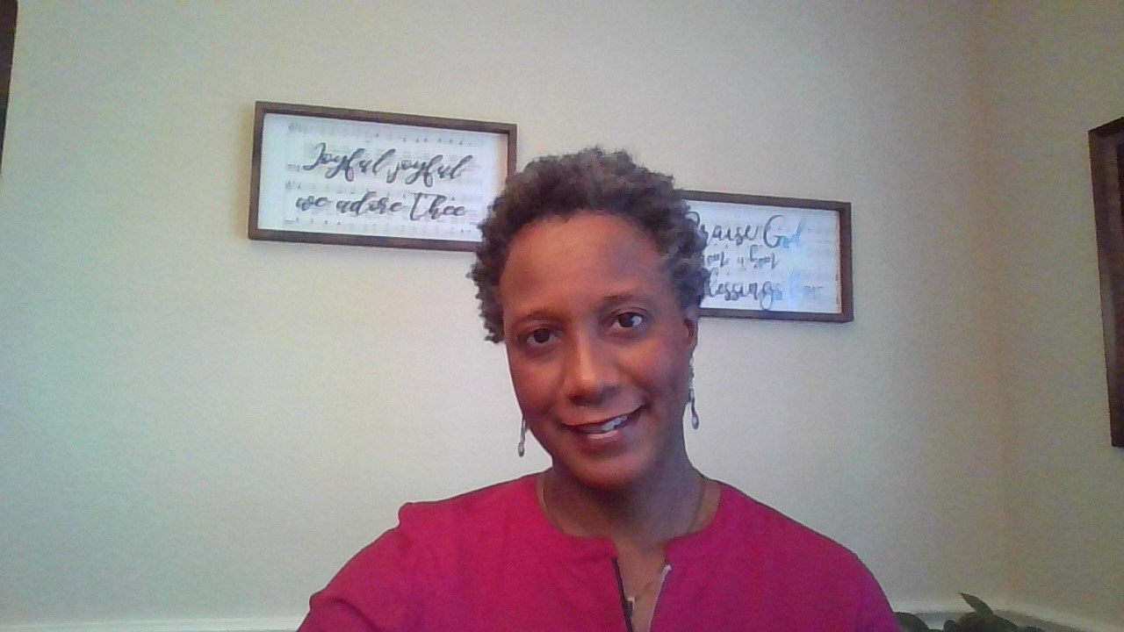
TOUR GUIDE
D.R.E.A.M FREEDOM TOUR – History of Dallas
Dr. Tonjia Grimble
Association Senior Director of Teen Programs
YMCA OF METROPOLITAN DALLAS

Slide 8
WELCOME TO THE OLD NORTH DALLAS
D.R.E.A.M FREEDOM TOUR – History of Dallas

Slide 9
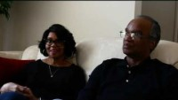
HIDDEN HISTORY DFW
Source: HIDDEN HISTORY DFW

Slide 10
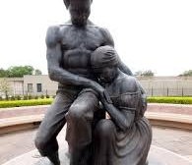
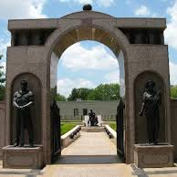
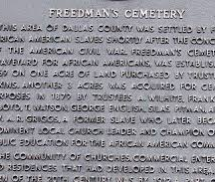
FREEDMAN’S TOWN
During 1865, thousands of African Americans gathered for a new life in Freedman’s Town
As a starter neighborhood for blacks, they built shotgun style homes, churches and saloons
By 1868 the Reconstruction Period began.
Blacks were slowly being force to move further south of Dallas.
In the 1920’s, railroads ran through the heart of Freedman’s Town.
However, by the 1940’s, 1500 African Americans were replaced by the city’s first freeway.
Notes:
“As we are, they once were, and as they are, we soon shall be,” said Donald Payton, president of the African American Genealogy Interest Group
He’s referring to the thousands of African Americans who gathered here to start a new life after the Civil War. In the following years, they built a buzzing neighborhood of shotgun style homes, lively churches and saloons described like “the devil’s rest stop on Earth.” They called it Freedman’s town, and all that remains is the unmarked cemetery where Payton stood.
Back in the 1920s, Dallas City Planner George E. Kessler purchased The Houston and Texas Central Railroad (H&TC) and the Texas and Pacific Railroad (T&P), which ran through the heart of Freedman’s Town. By the 1940s, the railroad and the homes of 1,500 African Americans were replaced by the city’s first freeway. When plans to expand the freeway 50 years later, in the 1990s, were disrupted by the discovery of a body, the city realized they had paved over an acre’s worth of Freedman’s Cemetery.
Juneteenth liberated Texas slaves.
Slaves worked the railroads before the civil war and emancipation.

Slide 11
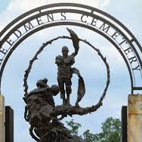
FREEDMAN’S CEMETARY
50 years later, plans to expand freeway begin in North Dallas
Construction stopped due to the discovery of a body
The City of Dallas paved over an acre’s worth of Freedman’s Cemetery
Frances James, aka “Cemetery Lady”, fought to preserve the cemetery with the discovery of a stone used as a headstone marker
Archaeologist used toothbrushes and toothpicks while digging and the project took several years
Many bodies were buried on top of others
Cost taxpayers $12 million to dig and move over 2000 remains
As we are, they once were, and as they are, we soon shall be.
– Donald Payton
Notes:
“As we are, they once were, and as they are, we soon shall be,” said Donald Payton, president of the African American Genealogy Interest Group
He’s referring to the thousands of African Americans who gathered here to start a new life after the Civil War. In the following years, they built a buzzing neighborhood of shotgun style homes, lively churches and saloons described like “the devil’s rest stop on Earth.” They called it Freedman’s town, and all that remains is the unmarked cemetery where Payton stood.
Back in the 1920s, Dallas City Planner George E. Kessler purchased The Houston and Texas Central Railroad (H&TC) and the Texas and Pacific Railroad (T&P), which ran through the heart of Freedman’s Town. By the 1940s, the railroad and the homes of 1,500 African Americans were replaced by the city’s first freeway. When plans to expand the freeway 50 years later, in the 1990s, were disrupted by the discovery of a body, the city realized they had paved over an acre’s worth of Freedman’s Cemetery.
Juneteenth liberated Texas slaves.
Slaves worked the railroads before the civil war and emancipation.

Slide 12
WELCOME TO THE DEEP ELLUM
D.R.E.A.M FREEDOM TOUR – History of Dallas
Notes:
https://open.spotify.com/track/3bNPafCe69TJzCMJSVQPKv?si=b5ce8366ca864bbe

Slide 13
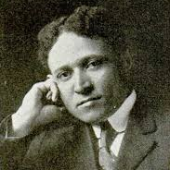
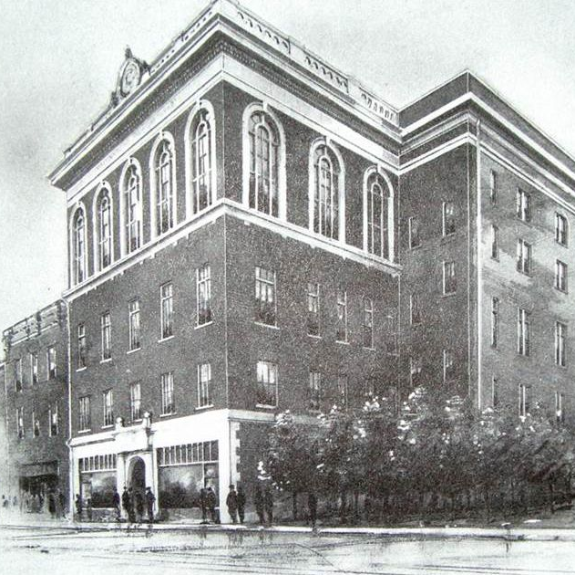
THE HISTORY OF DEEP ELLUM
Part of Freedman’s Town
The Colored Knights of Pythias Temple was completed in 1916
The four-story structure was designed by black architect William Sydney Pittman
This building provided the black community with Dallas black doctors, dentist, drugstore, business and legal professionals
The fourth floor displayed a ballroom with the most extravagate chandelier and brought in entertainers from around the world
George Washington Carver demonstrated sweet potato products for an audience of 800 blacks
In 1907, William Sydney Pittman married Portia Washington becoming the son-in-law to Booker T. Washington
Notes:
https://parksfordowntowndallas.org/the-history-of-deep-ellum/

Slide 14
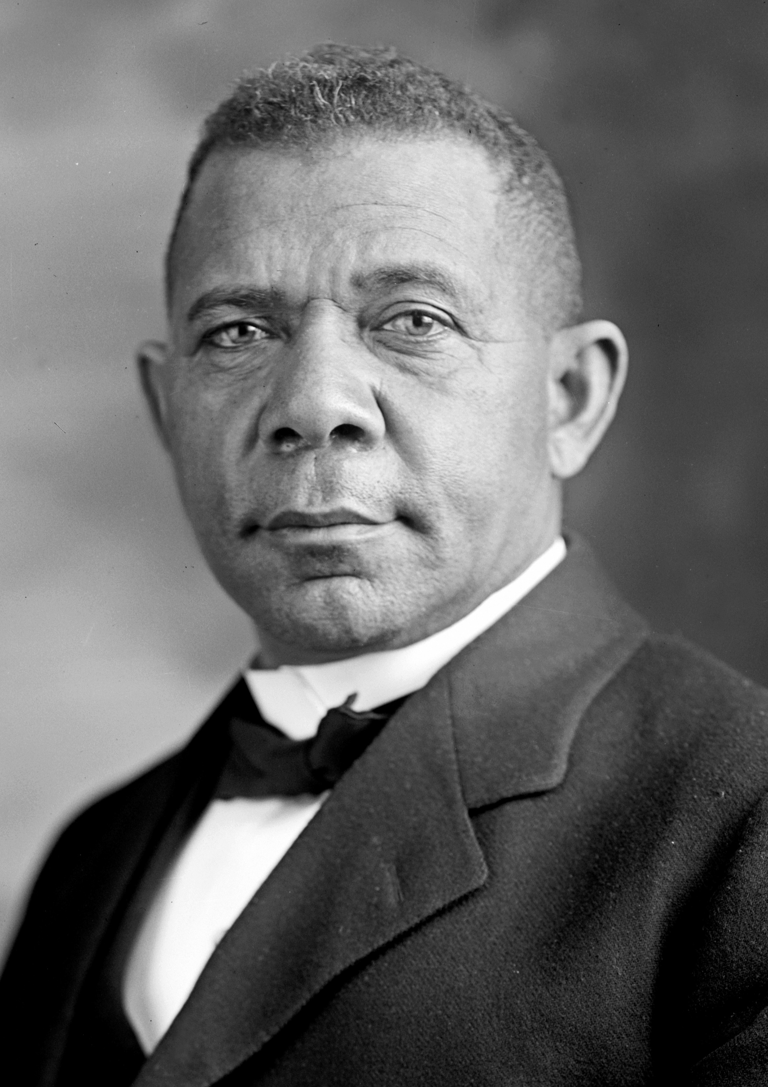
BOOKER T. WASHINGTON HIGH SCHOOL
Booker Taliaferro Washington (1856-1915) was born into slavery and rose to become a leading African American intellectual of the 19 century, founding Tuskegee Normal and Industrial Institute (Now Tuskegee University) in 1881 and the National Negro Business League two decades later. Washington advised Presidents Theodore Roosevelt and William Howard Taft. His infamous conflicts with Black leaders like W. E. B. Du Bois over segregation caused a stir, but today, he is remembered as the most influential African American speaker of his time.
Source: HISTORY CHANNEL

Slide 15
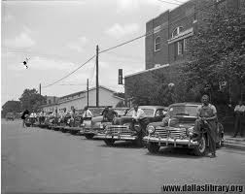
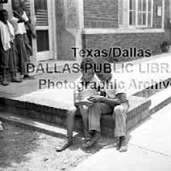
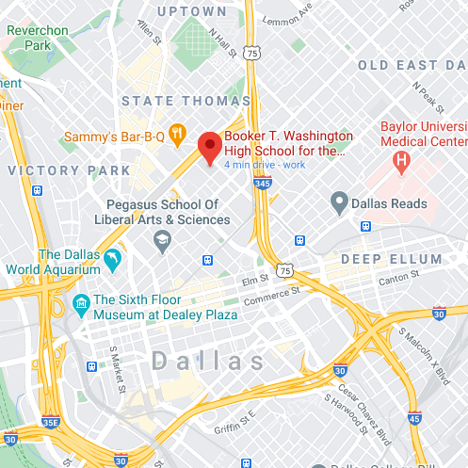
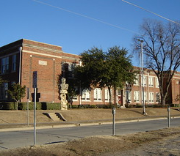
BOOKER T. WASHINGTON HIGH SCHOOL and the Moorland YMCA
Norman W. Harllee was the first black Principal of the Colored High School
In 1922, overcrowding moved the school to Flora and Fairmount
It was renamed Booker T. Washington High School
In 1902, group of African American men with a similar organization merged with the Dallas YMCA
To service the growing population, the Moorland YMCA was established in 1928 down the street from Booker T. Washington
For many years, Booker T. Washington was the only top performing arts school for all blacks in Texas
Notes:
https://www.dallasisd.org/Page/1606
https://dallascityhall.com/departments/sustainabledevelopment/historicpreservation/HP%20Documents/Landmark%20Structures/Booker%20T.%20Washington%20High%20School%20Landmark%20Designation%20Report.pdf
https://www.google.com/maps/place/Booker+T.+Washington+High+School+for+the+Performing+and+Visual+Arts/@32.7921981,-96.7970939,16z/data=!4m5!3m4!1s0x0:0x14a228230a940612!8m2!3d32.7915487!4d-96.7967506

Slide 16
BREAK-OUT DISCUSSION
D.R.E.A.M FREEDOM TOUR – History of Dallas
How do you think the Reconstruction Period affected communities like Freedman’s Town? (Highways, Railroads, Housing Expansions, etc.)
Provide specific examples within your groups.
Notes:
How do you think changes in city redevelopment affect communities like Old North Dallas? (Highways, Railroads, and ____ )
How do you think the Reconstruction Period affected communities like Freedman’s Town?
Provide specific examples within your groups.

Slide 17
GROUP DISCUSSION
D.R.E.A.M FREEDOM TOUR – History of Dallas

Slide 18
INDEPENDENT STUDY
D.R.E.A.M FREEDOM TOUR – History of Dallas
RESEARCH: REDLINING & ENVIRONMENTAL RACISM

Slide 19
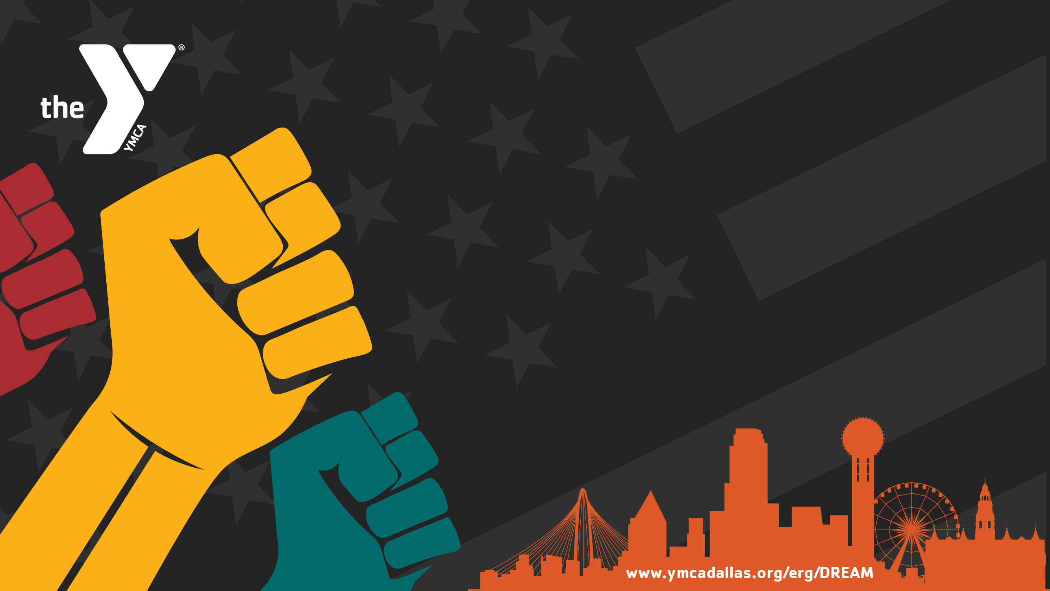
THANK YOU!
For more information about D.R.E.A.M
or Anti-Racism resources, visit: www.ymcadallas.org/erg/DREAM
You are listening to Fisk Jubilee Singers, Rock My Soul. They performed at the Colored Knights of Pythias Temple in Deep Ellum.

Slide 20
